Slide 1



Slide 2
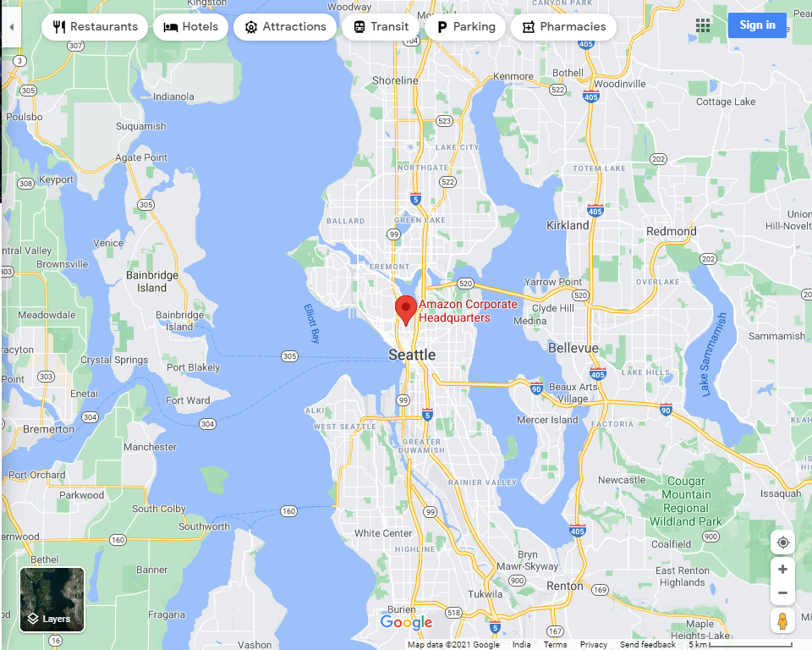
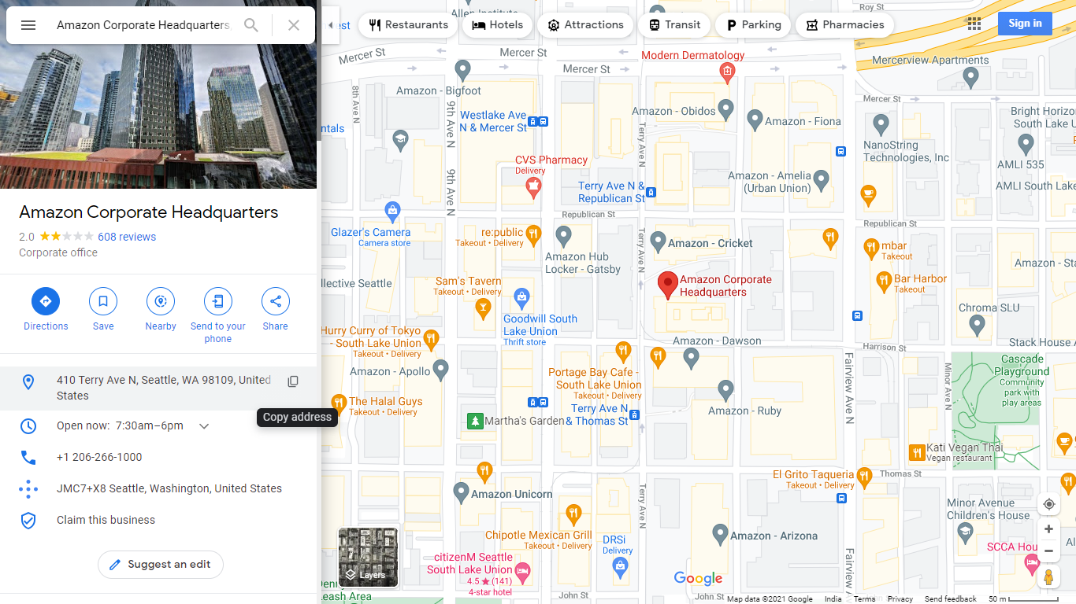
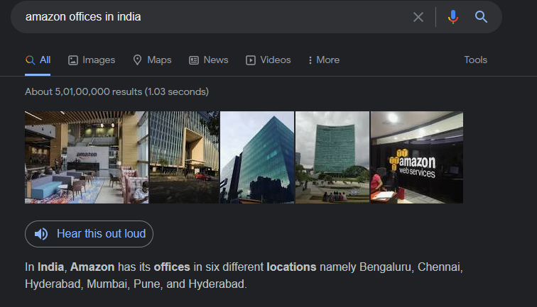
Amazon
Placements
World Largest Online Retailer
TimeLine
FAANG Company
Employees
Main Head Quarters
History
Locations in India
About

Slide 3
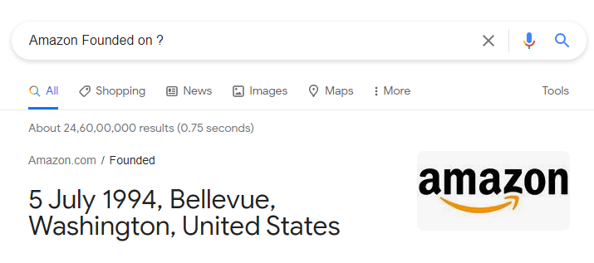
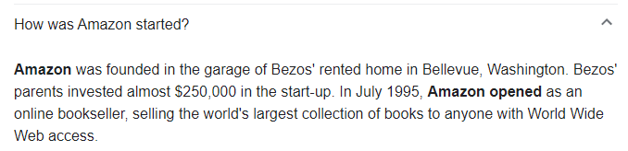
History
Placements
Foundation Date
TimeLine
Started As
Employees
History
About

Slide 4
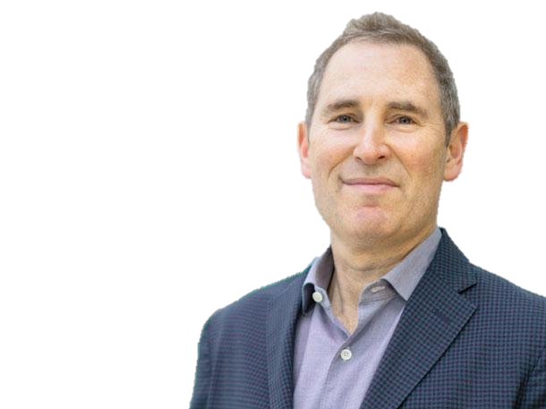
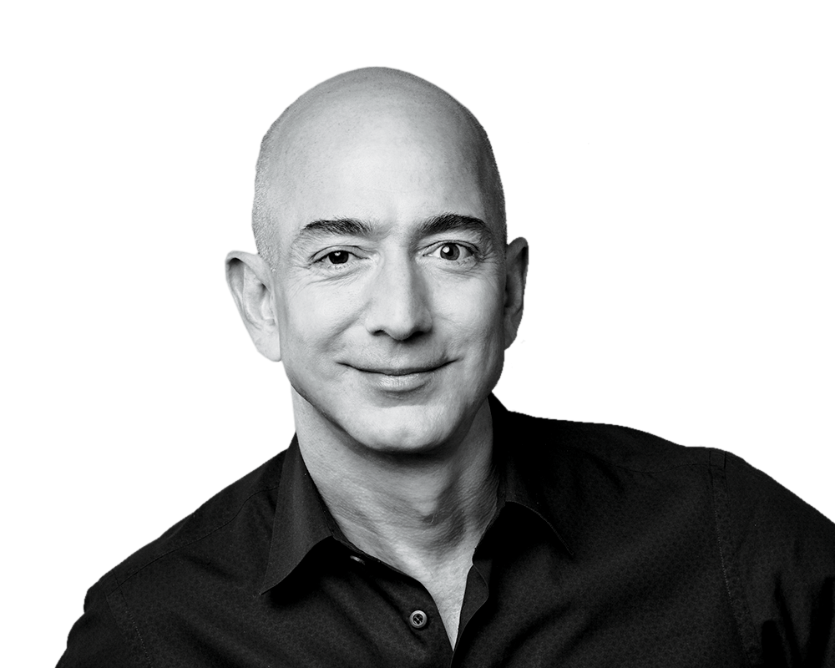
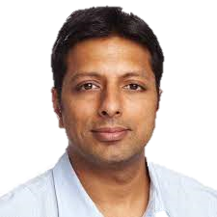
Employees
Placements
Founder : Jeff Bezos
TimeLine
CEO and President : Andy Jassy
Employees
Head Of Amazon India :
Amit Agarwal
History
About

Slide 5

TimeLine
Placements
Lawsuits against Barnes
& Noble
TimeLine
Amazon Founded
Employees
1997
2003
History
About
1994
2000
Expanded Beyond Books
IPO’s at $18.00/Share
IMDB
Amazon Prime
Amazon Mechanical Turk
Joyo
A9.com

Slide 6

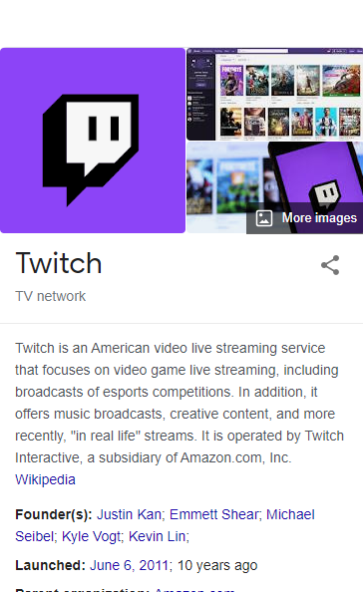
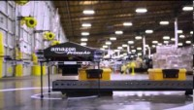
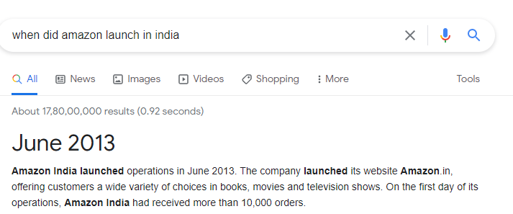
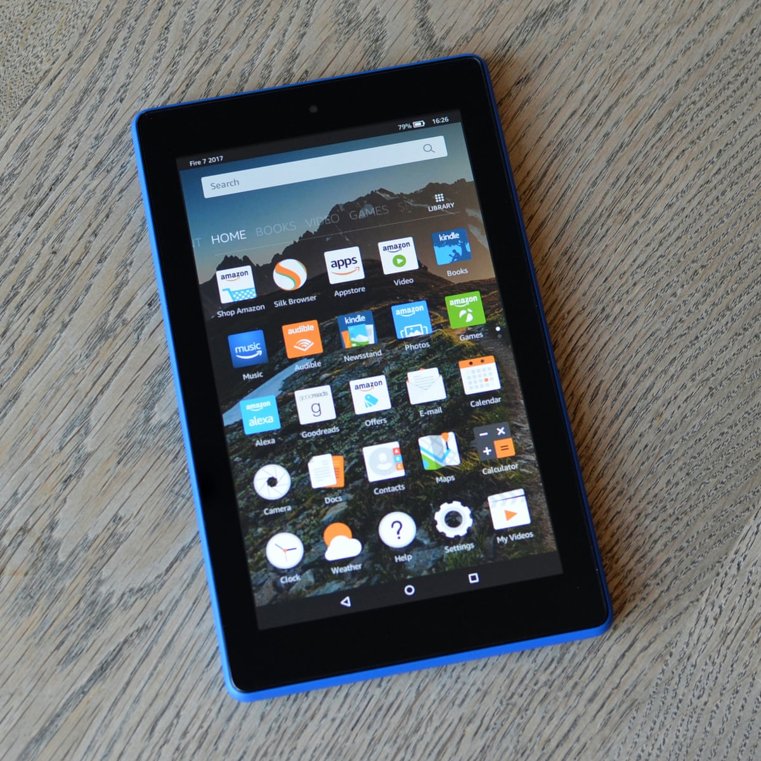
TimeLine
Amazon Web Services
Amazon Music
Amazon Kindle
Amazon Fresh
Audible
Amazon Launches in India
Kindle Fire
Twitch
GoodReads
Placements
TimeLine
Employees
2009
2015
History
About
2006
2012
Amazon AppStore
Amazon Instant Video
Zappos
Kindle e-Books outsell hardcover books
Search For 2nd HQ
Amazon Prime Air
Whole Foods

Slide 7

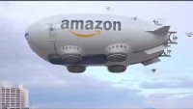
TimeLine
Placements
25th year Anniversary
Amazon Care
HQ For NY
Amazon Go
TimeLine
Employees
2021
History
About
2018

Slide 8
Placements
Placements
TimeLine
What Branches Do They Take.
No. Of students They Take
On-Campus
Off-Campus
Employees
History
About

Slide 9
Placements
TimeLine
Employees
History
About

